Slide 1
Capstone Data Exploration
By Elke Hansen

Slide 2
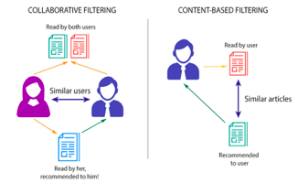
Recommendation Engine Recap
Collaborative Filtering:
Needs a large amount of data per customer
Content-based Filtering: Needs large amounts of product based data

Slide 3
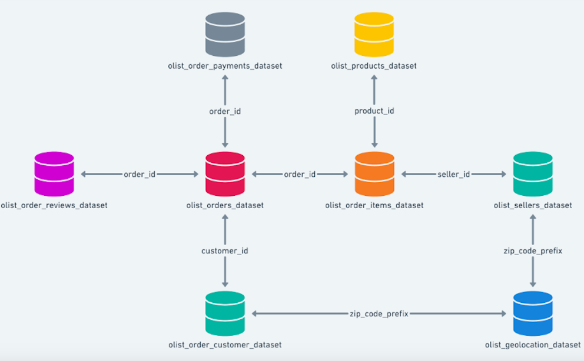
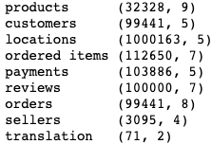
Data Schema: Brazilian E-Commerce - Olist
8 different dataframes plus 1 for translating category information
Varying shapes across each one:
Start with ordered items as it has the most amount of information in it

Slide 4
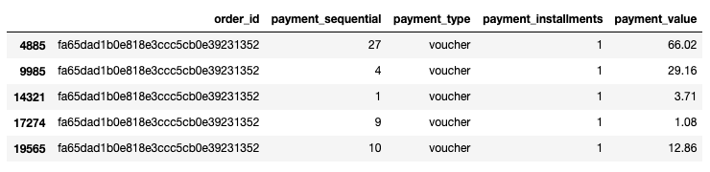
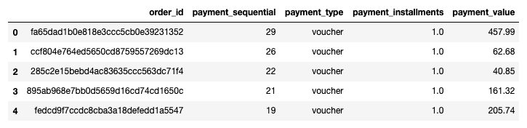
When merging goes wrong
Successfully merged the first 5 dataframes checking the shape as I go
Problems arise with payments and reviews creating extra rows
Created a new dataframe summarising these duplicate orders using:
Count of payment installments
Mode of payment type
Sum of payment value

Slide 5
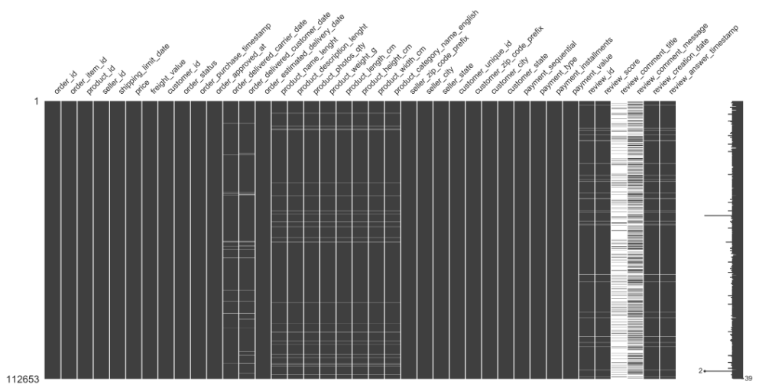
Cleaning Missing Values
Drop Columns review_comment_title and review_comment_message
Drop all other NAs in reviews and product information
Still kept 107,285 rows
Drop several other columns that are of no use

Slide 6
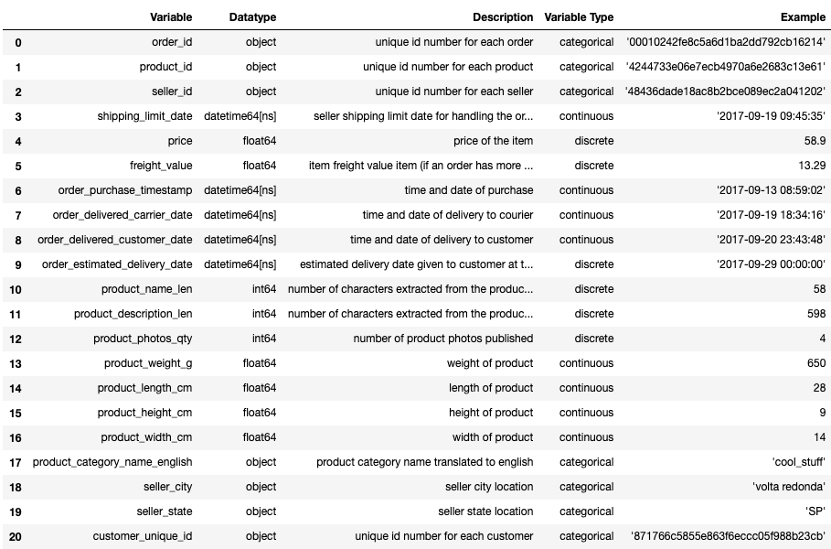
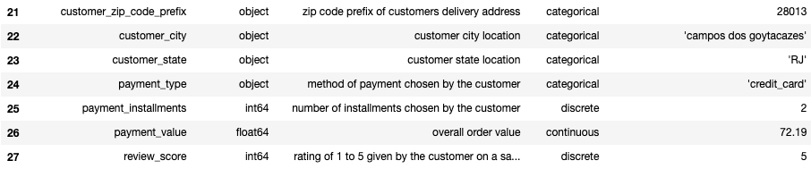
Data Dictionary
Final Dataframe contains:
11 categorical variables
5 time variables
7 discrete numerical variables
5 continuous numerical variables
Many of these variables may not be useful towards the final model but will be helpful for feature extraction

Slide 7
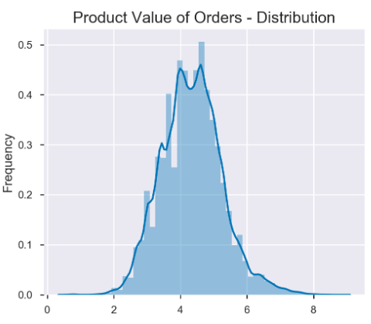
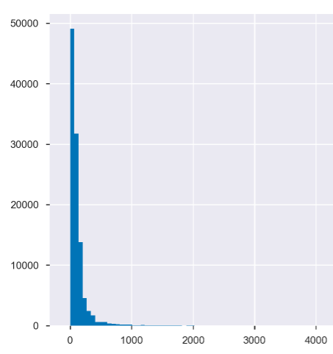
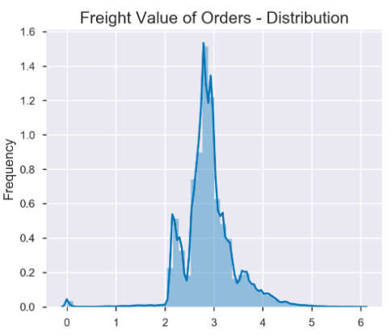
Numerical Variables
Most are highly skewed so difficult to look at with regular histogram
After log transformation, can compare item prices with their freight cost
Price is now nicely normally distributed
Based on domain knowledge, freight costs look as expected

Slide 8
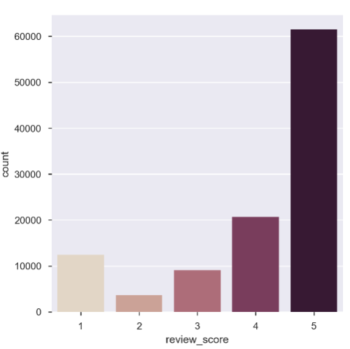
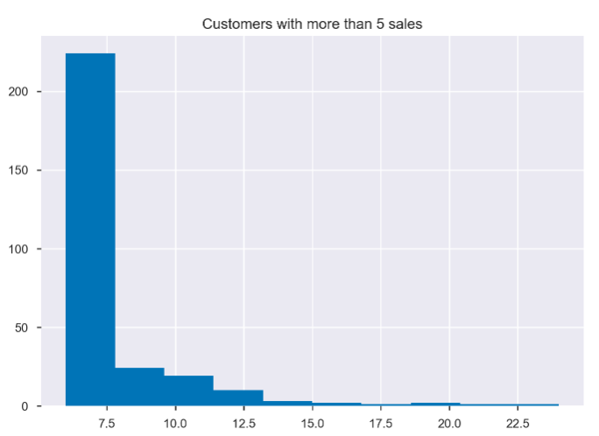
Customers
55.5% of the ratings are a 5
Difficult to use this for a general categorisation model
80% of customers have only made 1 purchase
A collaborative based filtering model will be virtually impossible because of this

Slide 9
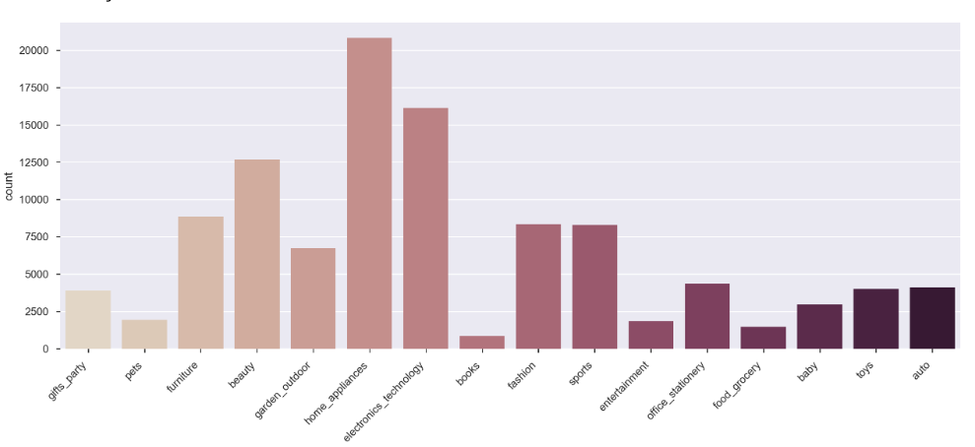
Categories
Original data had 71 different categories with sales ranging from 2 to 10,671
Summarised this down to 16 more general categories
These now have sales against them ranging from 853 to 20,819
These will be a lot easier to work with in the model

Slide 10
Where to now?
Creation of new features:
Days to ship
Whether or not seller made shipping limit date
Whether or not order was received within estimated delivery date
Features I am predicting will be of importance to the model:
User rating
Price
Category
States (or seller and customer)
Shipping time

Slide 11
Steps to Modelling
Segmentation of the data using k means clustering
Use different segments created by this and make different models for each
If all else fails: logistics model

